Slide 1
Big Data Frameworks(CSE3120)
Insights ON Amazon Mobile Phones
Mukkamalla Harsha Vardhan Reddy(20MIA1083)
Linga Harish Kumar(20MIA1127)
Roshan Kumar(20MIA1156

Slide 2
Introduction:
Our ability to purchase goods online has been transformed by mobile devices, which put all the information at our fingertips. More and more customers will turn to other customers for product information instead of the seller's information as information access gets easier. Examples of this kind of information include reviews and ratings left by customers, which have already influenced many customers' purchasing decisions. Customers may make educated decisions and feel confident about them thanks to the transparent system created by the review and ratings platforms offered by eCommerce businesses.
Product reviews may be found in abundance on Amazon.com, and their review system is available through all available channels and presents reviews in an intuitive layout. The product reviewer gives the item a rating between 1 and 5, along with their own opinion based on their whole experience. To get the final product rating, the mean value from all the ratings is determined. By allowing others to vote on whether or not a review is useful, both the review and the reviewer gain credibility.

Slide 3
Data Source
The datasets is taken from the Kaagle datasets.
It contains more than 400,000 reviews from Amazon's unlocked mobile phone category.
PromptCloud extracted 400 thousand reviews of unlocked mobile phones sold on Amazon.com to find out insights with respect to reviews, ratings, price and their relationships.
Datasets have the fields:
Product Title
Brand
Price
Rating
Review text
Number of people who found the review helpful

Slide 4
Product Name
The name of the Product. e.g. Sprint EPIC 4G Galaxy SPH-D7
It contains 4410 Unique Values.
Brand Name
Name of the parent company. e.g. Samsung
Samsung16%
[null]16%
Other (282922)68%
Price
Price of the product. (Max: 2598, Min: 1.73, Mean: 226.86)
Ratings
Rating of the product ranging between 1-5
Reviews(Description of the user experience)
Review Votes(Number of people voted the review (Min: 0, Max: 645, Mean: 1.50))

Slide 5
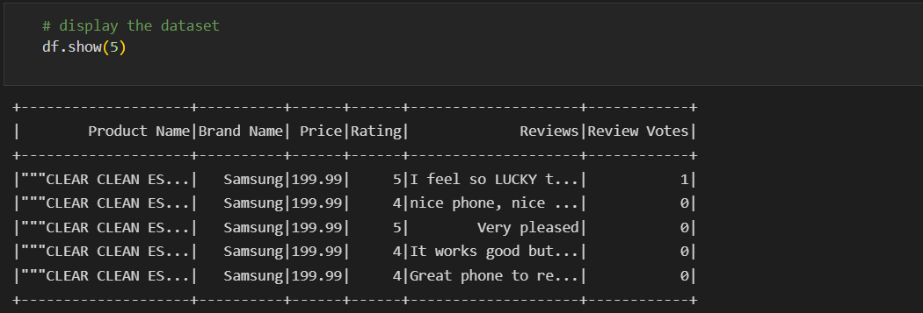
Sample Dataset

Slide 6
Libraries Used
Pyspark
Pandas
Matplotlib
seaborn
Sklearn

Slide 7
Model Building
We will be predicting the rating of the mobile phone
Our independent variable is mobile name , brand name , price , reviews
Our dependent variable is rating
We used some ml models
They are naïve bayes , logistic regression , random forest tree
We converted the categorical variable to numerical variable using label encoding
We used TFDIF label encoding
We removed stop-words and did tokenization on the text data

Slide 8
Model Acurracy
We got highest accuracy in Logistic Regression
Logistic Regression :
Accuracy: 0.5396560884895909
Precision: 0.48746599312436023
Recall: 0.5396560884895908
F1 Score: 0.3901890112525952
Decision Tree classifier
Accuracy: 0.5290698610507334
Precision: 0.3314578038398621
Recall: 0.5290698610507334
F1 Score: 0.3674930330395204

Slide 9
Naive Bayes classifier:
Accuracy: 0.5200615047738653
Precision: 0.4379434522510633
Recall: 0.5200615047738654
F1 Score: 0.39322363287054907
Random forest classifier:
Accuracy: 0.5223961100645639
Precision: 0.4173603011272721
Recall: 0.5223961100645639
F1 Score: 0.3586813433651473

Slide 10
Conclusion
Using the price , review , brand name we predicted the rating of the particular mobile phone

